Slide 1
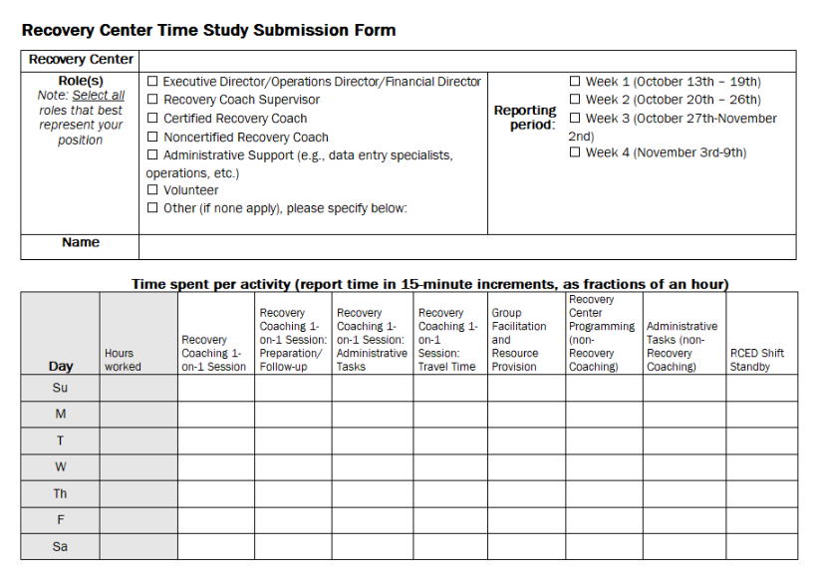
Time Study Form: Word Template

Slide 2
Time Study Form: Word Template Instructions
Note: You may enter your responses directly in the Word document OR print this form and enter your responses.
Enter the name of your Recovery Center.
Select the checkbox or checkboxes that most closely align to your role(s) at your Recovery Center. If none of the listed roles apply, select “other” and enter your role title.
Enter your name.
Select the checkbox for the week you are reporting your time.
Please complete one form for each week of the time study. To create an accurate and complete record, complete the form at the end of each workday.

Slide 3
Time Study Form: Word Template Instructions 2
Time Study Form: Word Template Instructions
For each activity listed in the of the “Time Spent per Activity” table, enter the total amount of time you spent on the activity each day. Report your time in 15-minute increments as fractions of an hour (e.g., 0.25, 0.5, 0.75, 1, etc.)
If you did not work on a specific date, do not complete the row.
Please round down or up to the nearest 15-minute increment.
The categories may not describe all your work; it is okay if your hours worked is more than the total time indicated in each column for each day.

Slide 4
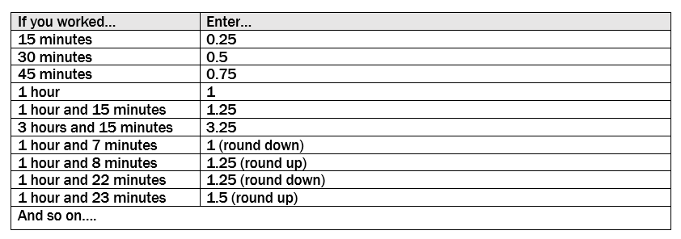
Time Study Form: How to Calculate Time Spent (15-minute increments, as fractions of an hour)
1 hour
1 hour
15 min
15 min
15 min
15 min

Slide 5
How to calculate time spent 2
Time Study Form: How to Calculate Time Spent (15-minute increments, as fractions of an hour)
1 hour
1 hour
0.25
15 min
15 min
15 min
15 min

Slide 6
How to calculate time spent 3
Time Study Form: How to Calculate Time Spent (15-minute increments, as fractions of an hour)
1 hour
1 hour
15 min
15 min
0.5
15 min
15 min

Slide 7
How to calculate time spent 4
Time Study Form: How to Calculate Time Spent (15-minute increments, as fractions of an hour)
1 hour
1 hour
0.75
15 min
15 min
15 min
15 min

Slide 8
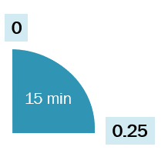
How to calculate time spent 5
Time Study Form: How to Calculate Time Spent (15-minute increments, as fractions of an hour)
1 hour and 7 minutes: round down to the nearest quarter
7 min
1
8 min
1 hour and 8 minutes: round up to the nearest quarter
1.25

Slide 9
Time Study Form: Word Template Instructions 3
Time Study Form: Word Template Instructions
At the end of each week, or per the guidance of your Recovery Center Director, give your Time Study form to your Recovery Center Director for their review, approval, and submission to the Vermont Department of Health.
Please contact your Recovery Center Director or leadership team if you have any questions regarding the completion of your Time Study submission form.

Slide 10
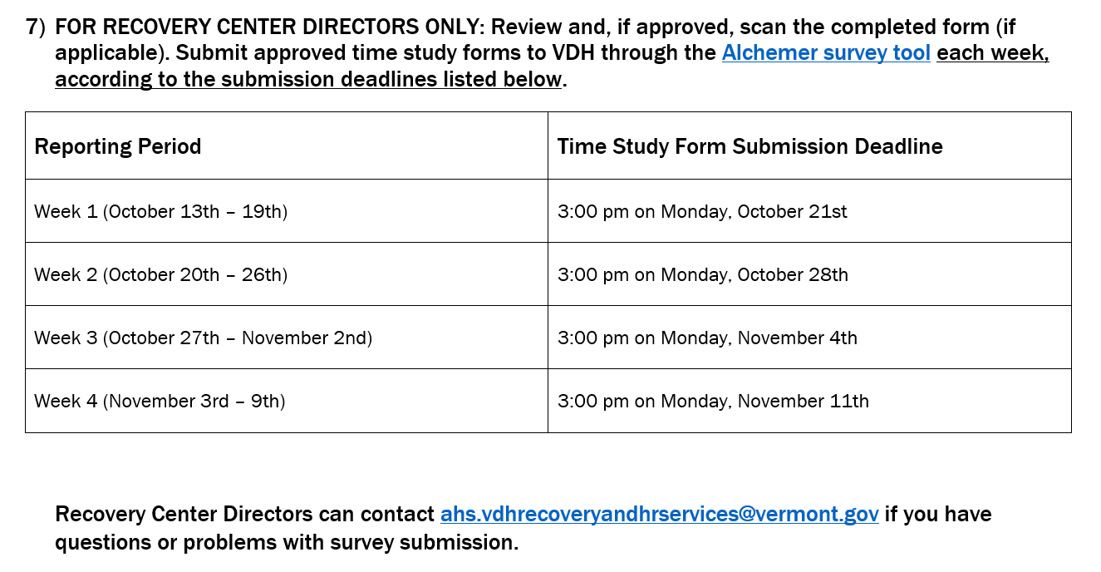
Time Study Form: Word Template Instructions 4
Time Study Form: Word Template Instructions

Slide 11
Time Study Activity Categories and Descriptions
Activity Category | Description/Examples
Hours worked | Total shift hours worked per day
Recovery Coaching 1-on-1 Session | Time spent with participant providing recovery coaching in-person or virtual (video or phone call): Recovery Coaching in the Center Recovery Coaching at another community location Recovery Coaching in the ED Parents in Recovery 1-on-1 sessions
Recovery Coaching 1-on-1 Session Preparation/Follow-up | Time spent preparing for recovery coaching session and following-up after session: Meeting scheduling Phone/email follow-ups (that are not a Recovery Coaching session)
Recovery Coaching 1-on-1 Session Administrative Tasks | Time spent on administrative tasks related to the documentation of Recovery Coaching 1-on-1 sessions and participant data: Creating participant records Data entry (in RDP or other Recovery Coaching related systems)
Recovery Coaching 1-on-1 Session Travel Time | Time spent traveling to and from 1-on-1 Recovery Coaching sessions
Group Facilitation and Resource Provision | Time spent providing the following: Directing individuals and providing referrals to community resources (outside of coaching-participant relationship) Facilitating recovery groups such as but not limited to Parents in Recovery groups and SMART Recovery. Preparing for and follow-up related to facilitating recovery groups.

Slide 12
Time Study Activity Categories and Descriptions 2
Activity Category | Description/Examples
Recovery Center Programming (non-Recovery Coaching) | Time spent supporting non-Recovery Coaching programming at the Recovery Center: Conducting outreach Hosting/facilitating recovery events Coordinating events conducted by external organizations Attending community meetings Program coordination
Administrative Tasks (non-Recovery Coaching) | Time spent on activities to support Recovery Center operations: Internal team meetings Timesheets Bookkeeping/accounting Staff training Professional development Supervision Board meetings Marketing activities (e.g., marketing material development, event presentation preparation, etc.) Procurement of goods/materials Non-Recovery Coaching documentation/data maintenance/management and IT services Grant writing and grant reporting Center reception Non-Recovery Coaching travel time
RCED Shift Standby | Standby time spent waiting for a call to the Emergency Department

Slide 13
Time Study Form: Excel Template

Slide 14
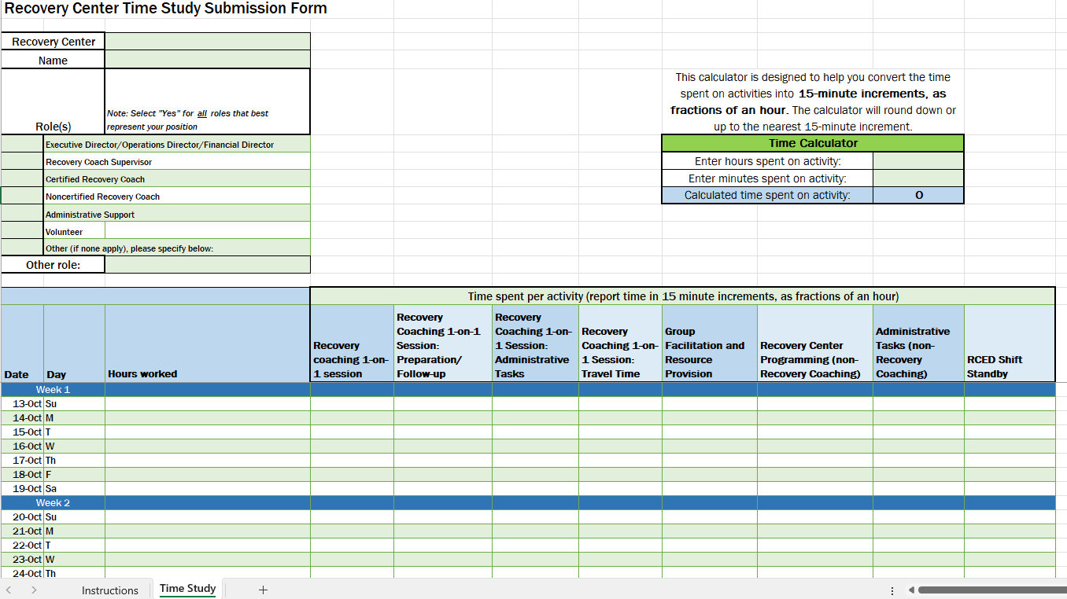
Time Study Form: Excel Template Instructions

Slide 15
Excel template instructions 2
Time Study Form: Excel Template Instructions
How to use the calculator tool
Purpose:
This calculator is designed to help you convert the time spent on activities into total minutes, ensuring that the time is rounded down or up to the nearest 15-minute increment.

Slide 16
Example 1:
Taylor is a Recovery Coach Supervisor at the recovery center and worked 9 hours today. Their time was split between administrative oversight, helping with center programming, and covering an ED shift.
Taylor worked on center strategic planning, staff oversight, and other administrative tasks for 3 hours.
Taylor helped coordinate and attend various non-coaching activities for 1 hour and 15 minutes.
Taylor took an RCED shift for 4 hours, covering while other staff were unavailable.
45 minutes were spent on tasks that do not fit into one of the defined activities.
Administrative Tasks (non-Recovery Coaching): 3 hours
Recovery Center Programming (non-Recovery Coaching): 1 hour and 15 minutes
RCED Shift: 4 hours
It is okay if your hours worked is more than the total time you recorded for time study activities each day.
Notes:
“Taylor, a Recovery Coach Supervisor, worked 8 hours today. Of those, 3 hours were spent on administrative tasks, which included staff oversight and budgeting. They also spent 1 hour and 15 minutes on non-coaching programming at the center, participating in and coordinating activities. Additionally, Taylor covered a 4-hour RCED shift. 45 minutes were spent on tasks that do not fit into one of the Time Study defined activities. Now, let’s walk through how to enter these activities into the time study tool.”

Slide 17
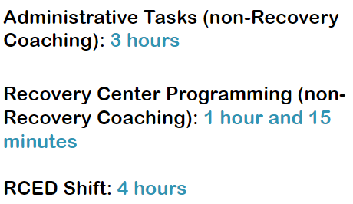
Example 1
Taylor is a Recovery Coach Supervisor at the recovery center and worked 9 hours today.

Slide 18
Example 2:
Jordan works part-time at the recovery center in two roles: as a Non-certified Recovery Coach and as Administrative Support. Today, Jordan worked a total of 7 hours. Their time was divided between direct recovery coaching sessions and general administrative duties.
Recovery Coach
Jordan held 4 one-on-one coaching sessions, each lasting 30 minutes.
Jordan spent a total of 1.5 hours preparing for and following up after sessions
Jordan traveled for 1 of the sessions, which included 30 minutes of travel.
Jordan helped run one group session for 2 hours.
Administrative Support
Jordan spent 1 hour entering data, filing paperwork, and supporting general center operations
Recovery Coaching 1-on-1: 2 hours
Recovery Coaching 1-on-1 Prep/Follow-up: 1.5 hours
Recovery Coaching 1-on-1 Travel: 0.5 hours
Group Facilitation and Resource Provision: 2 hours
Administrative Tasks (non-Recovery Coaching): 1 hour
Notes:
“Jordan holds two part-time roles at the recovery center: a Noncertified Recovery Coach and Administrative Support. Today, Jordan worked 7 hours in total, splitting their time between both roles. As a Recovery Coach, Jordan spent 2 hours in one-on-one sessions, 1.5 hours on session prep and follow-up, 0.5 hours traveling to and from coaching sessions, and 2 hours helping facilitate a group session. This totals 6 hours in the coaching role. In their administrative role, Jordan worked another hour completing data entry, paperwork, and other general support tasks. In the next part of the training, we’ll review how to record activities for these two roles in the time study tool, with each activity entered in 15-minute increments.”

Slide 19
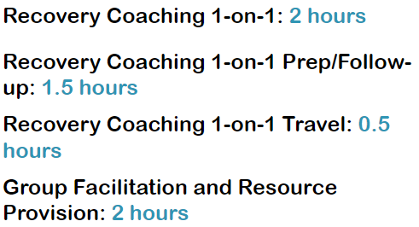
Example 2
Jordan works part-time at the recovery center in two roles: as a Non-certified Recovery Coach and as Administrative Support. Today, Jordan worked a total of 7 hours.

Slide 20
Example 3:
Alex is a volunteer at the recovery center and worked approximately 11 hours this week from Monday - Wednesday. They primarily supported administrative tasks and assisted with group activities.
Alex assisted with data entry and other administrative tasks for 6 hours and 13 minutes this week:
Monday: 2 hours
Tuesday: 2 hours
Wednesday: 2 hours and 13 minutes
Alex helped prepare for and run two group sessions.
Monday: 2 hours
Tuesday: 2 hours and 34 minutes
How would you record Alex’s week in the time study tool?
Notes:
“Alex is a volunteer who worked 10 hours and 43 minutes this week, and they worked on Monday, Tuesday, and Wednesday. They spent a little over 6 hours on administrative support, such as data entry, and another 4.5 hours assisting with group facilitation and resource provision. Record these activities in the time study tool, entering time in 15-minute increments, as fractions of an hour.”

Slide 21
How would you record Alex’s activities in the time study tool?
Alex assisted with data entry and other administrative tasks for 6 hours and 13 minutes this week:
Monday: 2 hours
Tuesday: 2 hours
Wednesday: 2 hours and 13 minutes
Alex helped prepare for and run two group sessions.
Monday: 2 hours
Tuesday: 2 hours and 34 minutes
Administrative Tasks (non-Recovery Coaching)
Group Facilitation and Resource Provision

Slide 22
How would you record Alex’s time in the time study tool?
Round up or down to the nearest 15-minute increment, as a fraction of an hour
Alex assisted with data entry and other administrative tasks for 6 hours and 13 minutes this week:
Monday: 2 hours
Tuesday: 2 hours
Wednesday: 2 hours and 13 minutes
Alex helped prepare for and run two group sessions.
Monday: 2 hours
Tuesday: 2 hours and 34 minutes
Administrative Tasks (non-Recovery Coaching)
Monday: 2
Tuesday: 2
Wednesday: 2.25
Group Facilitation and Resource Provision
Monday: 2
Tuesday: 2.5

Slide 23
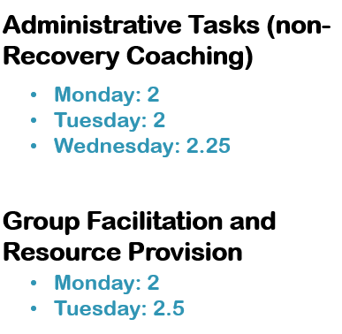
Example 3
Alex is a volunteer at the recovery center and worked approximately 11 hours this week from Monday - Wednesday. They primarily supported administrative tasks and assisted with group activities.

